Slide 1
Veins Simulation Framework
Tutorial 1: Introduction and SUMO
Nguyen Hoa Hung
Networked Smart Systems Laboratory
Pusan National University

Slide 2
Contents
Network Simulation
Simulation in Vehicular Networks
Veins Simulation Framework
SUMO Basic
SUMO More Examples
Exercise

Slide 3
Network Simulation
Using a software (simulator) to predicts the performance of a network without the need of real network
  Throughput, delay, etc.
Why simulation?
  Building and measuring the real network are difficult and expensive
  Mathematical analysis is too complex
  Simulation is fast, simple and inexpensive

Slide 4

Network Simulator
A software to create a model of a network
  Model of network entities: devices, links, channels and users
  Simulator usually provides model for common entities
Scenario
  Topology, generated traffic, mobility
  Model parameters
Statistics to collect
  Throughput, delay, channel load, etc.
  Statistics for each entities or entire network
Well-known simulators
  NS-2, OPNET, Qualnet, OMNET++, etc.
Network Simulator
Real World

Slide 5
Simulation in Vehicular Networks
Required dedicated mobility model
  Highly dynamics
  Within the road systems
Mobility simulator
  Provide the position of network entities in each time point.
  E.g. SUMO (Simulation of Urban MObility)
Bi-direction simulation
  Safety application required to intervene vehicle mobility
  Veins framework
Mobility Trace
Mobility simulator
Network Simulator
Control Mobility

Slide 6
Veins Simulation Framework
Veins (VEhicle In Network Simulation)
Built on top of OMNet++ network simulator
Interact with SUMO mobility simulation through TraCI (Traffic Command Interface)
Tutorial 3
TraCI
Veins
SUMO
Mobility simulator
OMNet++
Network Simulator
Tutorial 1
Tutorial 2

Slide 7
SUMO Basic

Slide 8
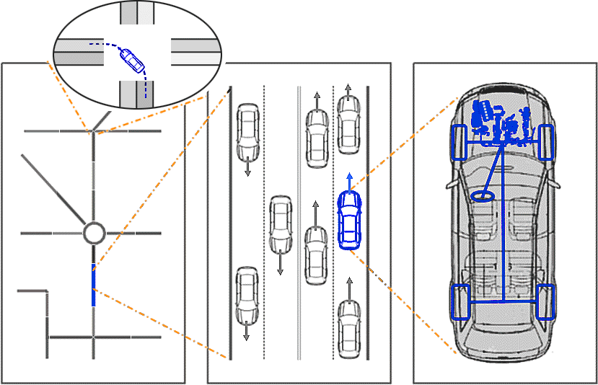
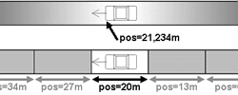
SUMO
SUMO Basic
SUMO (Simulation of Urban MObility)
  Microscopic traffic simulation
  Space-continuous and time-discrete
  SUMO wiki (http://sumo.dlr.de/wiki)
Mesoscopic
Macroscopic
Microscopic
Sub-microscopic

Slide 9
Install SUMO
SUMO Basic
Download from VCN2017 webboard
Unzip the file
All binaries are ready to use in ./bin folder
  sumo: The command line version of sumo
  sumo-gui: The GUI version of sumo
  netconvert: The utility to create net file
  netedit: The GUI utility to create net file

Slide 10
SUMO
SUMO Basic
Net file
Car following model,
Lane changing model, etc.
Route file
SUMO
Mobility simulator
Mobility trace file
Additional file
Config file
Net file: description about road network
Route file: vehicles definition and its route
Additional file: Traffic light schedule, bus stop, etc.
Config file: simulation parameters
Mobility trace file: Position and speed of each vehicle in each time step

Slide 11
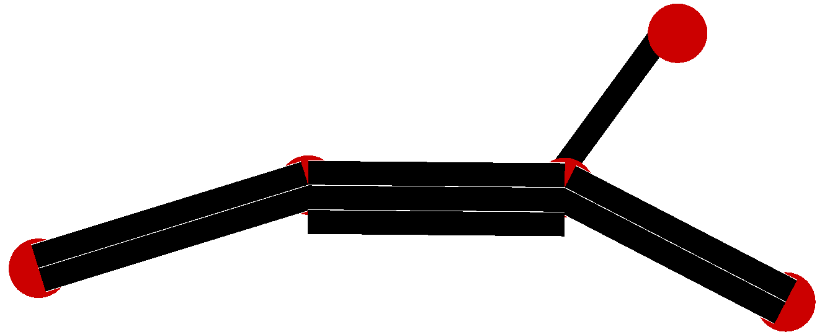
SUMO Road Network
SUMO Basic - Net File
Is a directed graph containing
  Node: intersection or connection point between two edges
  Edge: is unidirectional part of a road segment
    Each edge contains one or more lanes

Slide 12
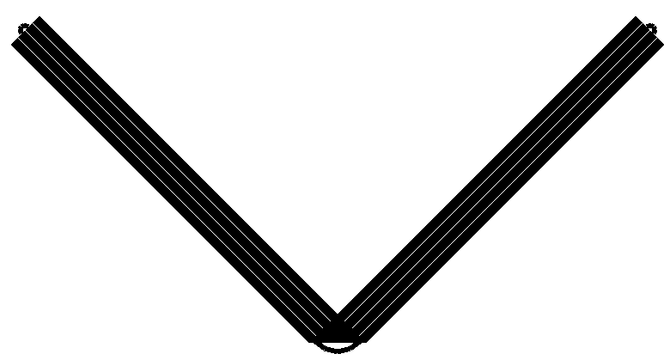
Tutorial Road Network
SUMO Basic - Net File
V-shaped road network
Bi-directional road
Two lanes per direction

Slide 13
Create Net File Manually
SUMO Basic - Net File
Node file
Edge file
Netconvert
Net File
Type file
Net config file
Node file: Node definition
Edge file: Edge definition
Type file: Edge type definition
Net config file: netconvert parameter
Net file: Output net file

Slide 14
Create Tutorial Net File Manually
SUMO Basic - Net File
<nodes>
<node id="1" x="0" y="100" />
<node id="2" x="100" y="0" />
<node id="3" x="200" y="100" />
</nodes>
Create node file
  Open text editor, enter and save as test1.nod.xml
Create edge file
  Save as test1.edg.xml
Create type file
  Save as test1.typ.xml
Create net config file
  Save as test1.netc.xml
Convert to net file
  Open cmd and run
  Check result test1.net.xml
1
2
<edges>
<edge id="1" from="1" to="2" type="1"/>
<edge id="2" from="2" to="3" type="1"/>
<edge id="3" from="2" to="1" type="1"/>
<edge id="4" from="3" to="2" type="1"/>
</edges>
<types>
<type id="1" numLanes="2" speed="30"/>
</types>
3
<configuration>
<input>
<node-files value=“test1.nod.xml"/>
<type-files value=“test1.typ.xml"/>
<edge-files value=“test1.edg.xml"/>
</input>
<output>
<output-file value=“test1.net.xml"/>
</output>
</configuration>
4
5
netconvert -c test1.netc.xml

Slide 15
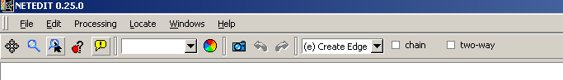
Create Net File with Netedit
SUMO Basic - Net File
Open netedit
File -> New network
In the droplist on toolbar -> select create edge
Click 2 points to create an edge
Select two-way to create bi-directional road

Slide 16
Change Node and Edge Parameters
SUMO Basic - Net File
In the droplist on toolbar -> select inspect
Node
  Pos: (x,y) position of the node
  Type: unregulated, priority, allway_stop, traffic_light
Edge
  Speed: maximum speed
  numLanes: number of lane
  Type: Edge types

Slide 17
Tutorial Vehicle Route
SUMO Basic - Route File
Create one vehicle to traverse all edges

Slide 18
SUMO Route
SUMO Basic - Route File
Contains vehicle definition and their route
vType: vehicle type definition
Route: route definition, contains a list of edges
Vehicle: vehicle definition
<routes>
<vType id="Car" length="4.0" accel="1.0" decel="5.0" maxSpeed="50.0"/>
<route id="0" edges="1 2 4 3"/>
<vehicle id=“car0" depart="1" route="0" type="Car" />
</routes>

Slide 19
Vehicle Type
SUMO Basic - Route File
length: Vehicle length
accel/decel: Maximum acceleration and deceleration rate
maxSpeed: Maximum speed
<routes>
<vType id="Car" length="4.0" accel="1.0" decel="5.0" maxSpeed="50.0"/>
<route id="0" edges="1 2 4 3 1"/>
<vehicle id=“car0" depart="1" route="0" type="Car" />
</routes>

Slide 20
SUMO Vehicle
SUMO Basic - Route File
type: Vehicle type
route: The route that vehicle travels
depart: The time to enter the road network
<routes>
<vType id="Car" length="4.0" accel="1.0" decel="5.0" maxSpeed="50.0"/>
<route id="0" edges="1 2 4 3 1"/>
<vehicle id=“car0" depart="1" route="0" type="Car" />
</routes>

Slide 21
SUMO Config File
SUMO Basic - Config File
input
  net file
  route file
output
  netstate-dump file (trace file)
time
  begin: start time
  end: end time
  step-length: simulation step
<configuration>
<input>
<net-file value="test1.net.xml"/>
<route-files value="test1.rou.xml"/>
</input>
<output>
<netstate-dump value="test1.tr.xml"/>
</output>
<time>
<begin value="0"/>
<end value="1000"/>
<step-length value="0.1"/>
</time>
</configuration>

Slide 22
Run SUMO in Command Line
SUMO Basic - Run SUMO
Run SUMO
Output
  Position and speed of every vehicle on edge and lane are recorded at every time step
sumo -c test1.cfg.xml
<netstate>
…
<timestep time="35.80">
<edge id="3">
<lane id="3_0"/>
<lane id="3_1">
<vehicle id="car0" pos="38.32" speed="26.43"/>
</lane>
</edge>
</timestep>
…
</netstate>

Slide 23
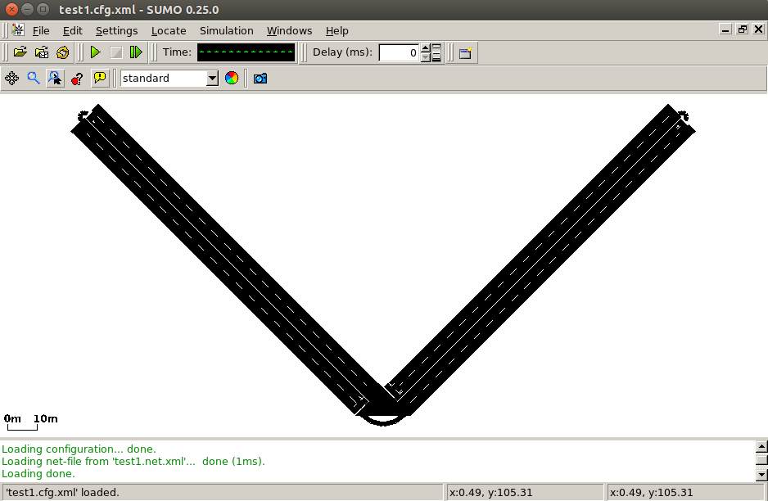
Run SUMO in GUI
SUMO Basic - Run SUMO
Run SUMO GUI
Adjust delay to 30 ms
sumo-gui -c test1.cfg.xml

Slide 24
More Examples

Slide 25
Create Vehicle Flow
More Examples
Flow: A list of vehicles travelling the same route
Create test2.rou.xml
Copy test1.cfg.xml to test2.cfg.xml, replace test1.rou.xml with test2.rou.xml
<routes>
<vType id="Car" length="4.0" accel="1.0" decel="5.0" maxSpeed="50.0"/>
<route id="0" edges="1 2 4 3 1"/>
<flow id="1" begin="0" end= "200" number="100" type="Car" route="0"/>
</routes>

Slide 26
Modify Vehicle Flow
More Examples
Available parameter
  departSpeed, arrivalSpeed
  departLane, arrivalLane
  departPos, arrivalPos
Create test3.rou.xml and test3.cfg.xml
Add departSpeed and arrivalSpeed
<routes>
<vType id="Car" length="4.0" accel="1.0" decel="5.0" maxSpeed="50.0"/>
<route id="0" edges="1 2 4 3 1"/>
<flow id="1" begin="0" end= "200" number="100" type="Car" route="0" departSpeed="30" arrivalSpeed="5"/>
</routes>

Slide 27
Modify Vehicle Type
More Examples
Available parameter
  tau: desired headway time
  minGap: minimum gap
  sigma: driver imperfect
Create test4.rou.xml and test4.cfg.xml
Add tau=“5”.
<routes>
<vType id="Car" length="4.0" accel="1.0" decel="5.0" maxSpeed="50.0" tau="5"/>
<route id="0" edges="1 2 4 3 1"/>
<flow id="1" begin="0" end= "200" number="100" type="Car" route="0" departSpeed="30" arrivalSpeed="5"/>
</routes>

Slide 28
Create Traffic Light
More Examples
Copy test1.net.xml to test5.net.xml, copy test4.cfg.xml to test5.cfg.xml
Edit test5.net.xml with netedit
  Choose inspect from toolbar
  Choose center node
  Change type to traffic light
  Choose traffic light from toolbar
  Change traffic light parameter

Slide 29
Exercise
Create 3x3 grid road network
Traffic light at each intersection
Create 12 vehicle flows to travel each line segment of the grid

